Slide 1
Gender and future of work
Virginija Langbakk
September, 2017

Slide 2
Future of work – what has gender to do with it?
Today’s labour and social policies as well as individual choices have strong impact on how the world of work is organised in the future;
The future of work may be ever more digital, but that does not tell all the story – jobs requiring human interaction are as important as technological advancements;
Ensuring that digitalisation is beneficial to women and men means addressing the digital gender gap at early stages;

Slide 3
Demographic change and labour market structure
Challenge 1: Demographic change implies more need for care work in the future. Currently this is done mostly by women.

Slide 4
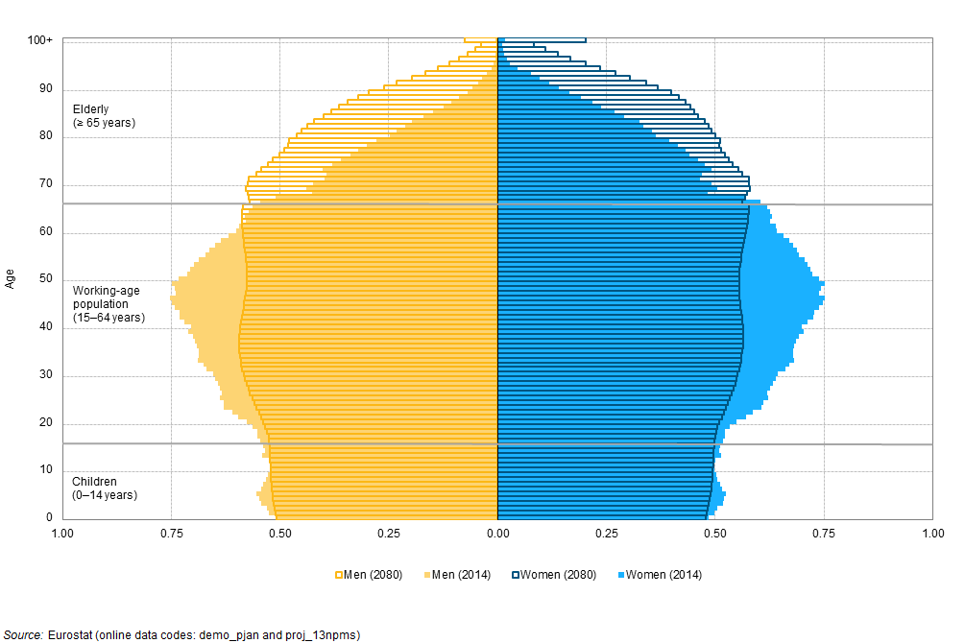
Demographic change and labour market structure

Slide 5
Demographic change and labour market structure: who will do care work?
Proportion of men among EHW graduates, by field of education and country (2013–2015)
Source: EIGE’s calculation, Eurostat, UOE data collection on education [educ_uoe_grad02].

Slide 6
Skills and qualifications for the future
Challenge 2: Low qualifications will lead to fewer employment opportunities.

Slide 7
Skills and qualifications for the future
Currently almost 23% of EU population aged 20-64 have low level education;
Over 6 million women (17 %) and 2 million men (6 %) with low levels of qualifications across the EU have never been employed
In 2025 almost half of all job openings in the EU will require high qualifications 40 % medium qualifications and only 11 % low or no qualifications

Slide 8
Gender segregation and its impacts on future of work
Challenge 3: Gender segregation is detrimental to the achievement of smart, sustainable and inclusive growth.

Slide 9
Gender segregation and its impacts on future of work
Gender segregation in STEM and EHW occupations, EU
Source: EU-LFS, calculations based on 2013–2014 microdata

Slide 10
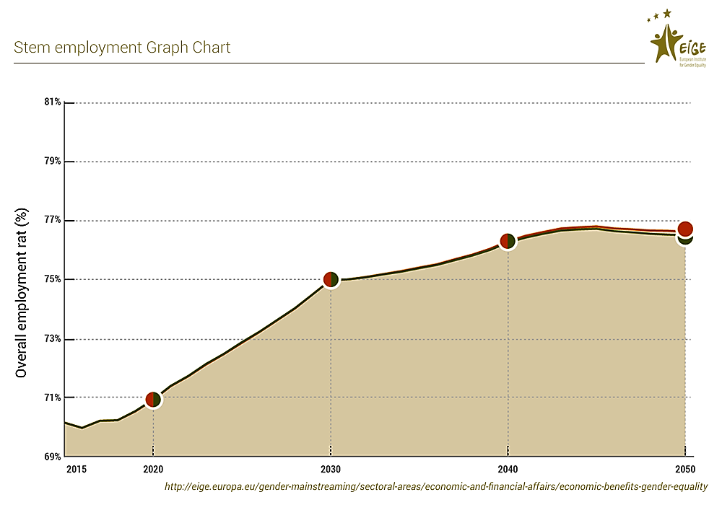
Gender segregation and its impacts on future of work
Employment impact on closing gender gaps in STEM education

Slide 11
Flexibility and work-life balance
Challenge 4: Digitalisation of work opens possibilities for more flexible work arrangements and work-life balance, but it also poses challenges to ensure that the benefits of these arrangements are fairly shared.

Slide 12
Flexibility and work-life balance
Women continue to perform more work in total, i.e. 55 hours per week in comparison with 49 hours worked by men (paid and unpaid work combined).
Work-life balance policies, as well as care policies are crucial for supporting women’s labour market participation and engaging men in more equitable share of caring duties.
Social protection systems need also to be adjusted in line with the new forms of employment and provide sufficient protection to those engaged in non-standard or precarious employment.

Slide 13
Future of work
The future of work is still uncertain, but one thing is clear - gender will play an important role in the way things unfold

