Slide 1
Gender Equality Statistics

Slide 2
EIGE’s Gender Statistics Database: a way to measure Gender Equality
Gender Equality Index
Gender Statistics Database
Notes:
In order to understand the extent of gender inequalities as accurately as possible, EIGE has developed two statistics-based tools: the Gender Equality Index and the Gender Statistics Database.
Although they are geared mainly towards policy-makers, the two resources are accessible to everyone, be it experienced statisticians or just people interested in gender matters.

Slide 3
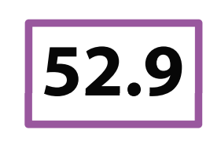
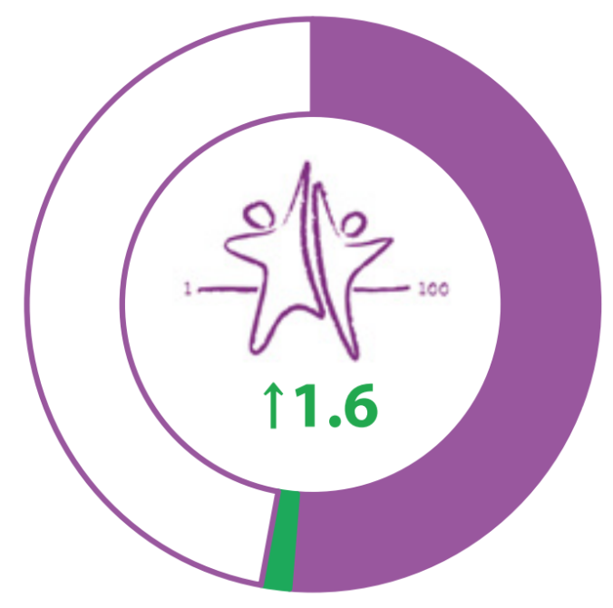
Gender Equality Index
Gender Equality Index
Notes:
First launched in 2013, the Gender Equality Index showed that overall the EU was only halfway towards equality. Its second edition in 2015 made it possible to observe key trends over time by introducing scores from 2005, 2010 and 2015.
In 2016, Serbia became the first non-EU country to produce its own gender equality index based on EIGE’s methodology. This tool is extremely useful both at a national level as well as in the country’s EU accession process.
The third edition of the Index will be released this year on 11 October and will feature new data, for example on health behavior and power relations in media, sports and the academia.

Slide 4
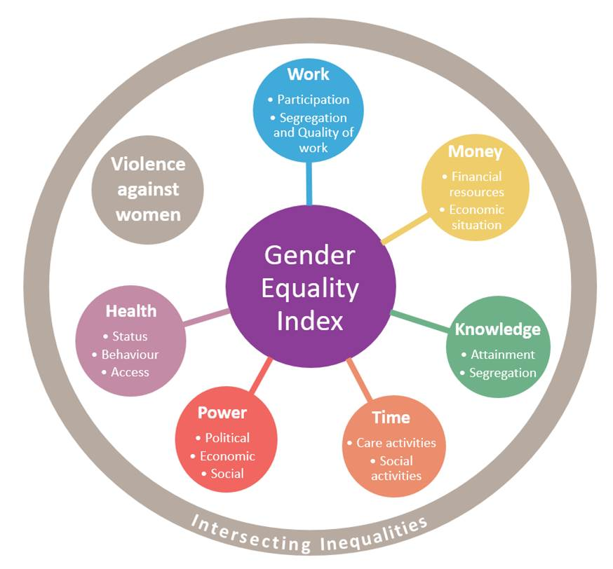
Gender Equality Index
Domains and sub-domains
Notes:
The Gender Equality Index measures the gender gap by awarding each country a score from 1 (total inequality) to 100 (full equality). The score can be viewed for overall gender equality performances or for each of the various domains included.
EIGE’s Index covers six core domains and 2 satellite domains, all linked closely with the policy priorities of the EU. The main domains are: money, work, power, health, knowledge and time, while the satellite domains address intersecting inequalities and violence against women. Each of these eight comes with its own set of sub-domains.

Slide 5
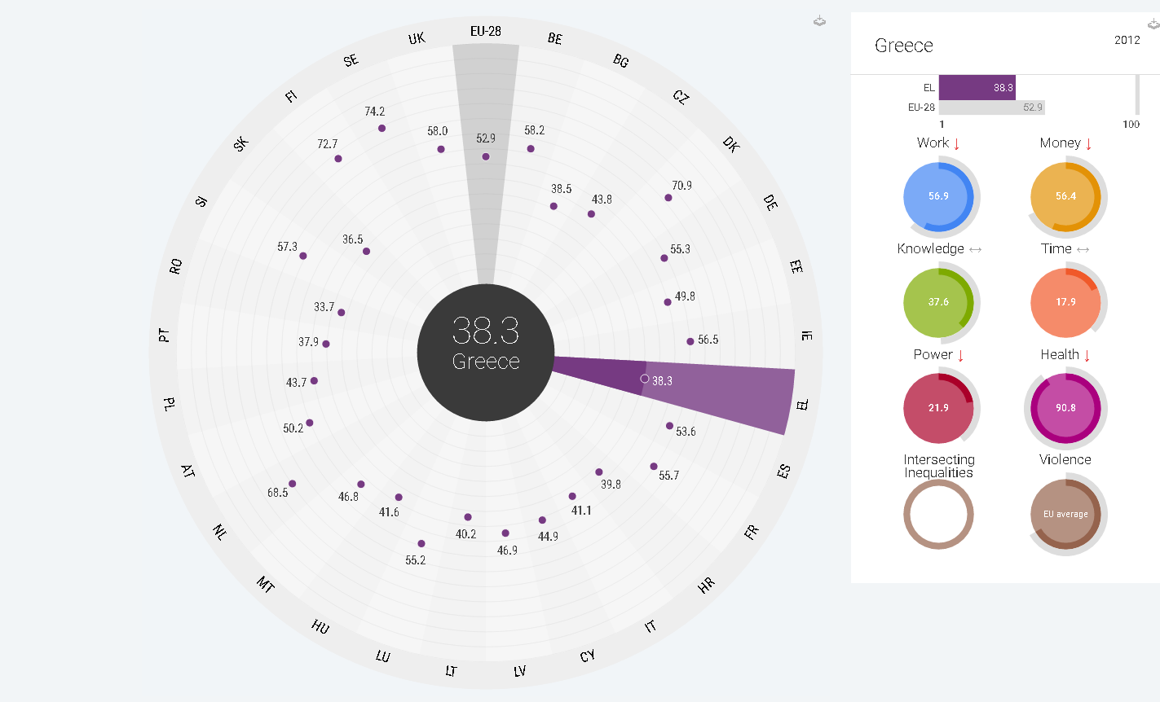

Gender Equality Index
Notes:
Earlier this year, EIGE has taken over the European Commission’s database on women and men in decision-making. The data is a valuable addition to our GSD, providing an EU-wide picture on gender imbalances in positions of power.
The figures shows a positive trend over the last 10 years, although there is still work to be done. The only domain with a balanced gender representation is Justice, although gender parity – equal representation – is still not visible in any area.
An important aspect to look at is political decision-making. In the EU, less than a third of national parliaments’ members are women, although this varies considerably across Member States, from 46.1% in Sweden to 9.5% in Hungary.

Slide 6






Gender Equality Index 2017
 | Revision of correcting coefficient +15 population
 | Job prospective included No correcting coefficient applied to segregation
 | No changes
 | Segregation moved between subdomains No correcting coefficient applied to segregation
 | Elderly and disabled included in caring activities All population considered for caring activities (workers and non-workers) No correcting coefficient applied to caring
 | Social power populated with new data Smoothing ‘jumps’ in time series of data on decision-making No correcting coefficient applied to the domain
 | Health behaviour populated with new data
Notes:
Currently used two variables:
Flexibility to take care of personal or family matters
Intensity of work
Intensity of work will be replaced by job prospects:
Employment status (self-employed or employee),
Type of contract
The prospects for career advancement as perceived by the worker
Perceived likelihood of losing one’s job
Experience of downsizing in the organisation.

Slide 7
Gender Statistics Database
Gender Statistics Database
Notes:
EIGE’s Gender Statistic Database is the online hub for all statistical information on gender equality.
It provides a broad overview of statistics on gender, highlighting differences and inequalities between both sexes. It also allows users to have a look behind the numbers to monitor trends, progress and other factors that might influence gender imbalances.
EIGE is always strengthening the Database’s potential to act as a reliable resource in formulating policies that are beneficial for both women and men. Nevertheless, it offers insight that is understandable and beneficial for broader audiences that don’t necessarily have statistical expertise.
In view of this goal, the Database was conceived as an user-friendly and interactive tool, easy to navigate through keyword searches or browsing the ‘statistics’ tree. It is also possible to export the data for personal use.

Slide 8
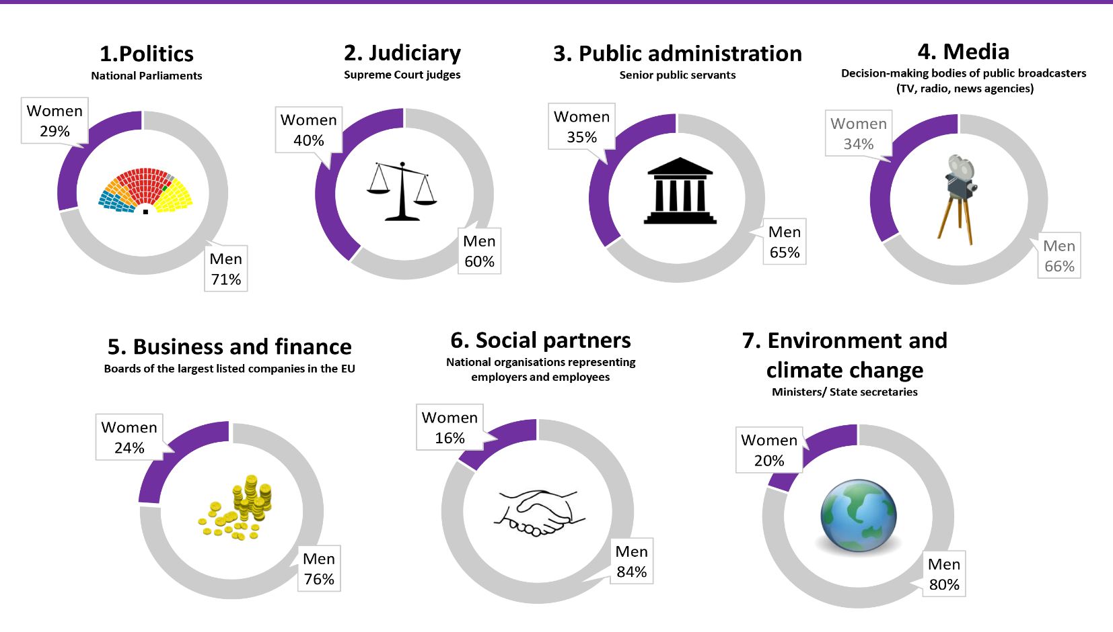
Latest data on women and men in decision-making
Notes:
Earlier this year, EIGE has taken over the European Commission’s database on women and men in decision-making. The data is a valuable addition to our GSD, providing an EU-wide picture on gender imbalances in positions of power.
The figures shows a positive trend over the last 10 years, although there is still work to be done. The only domain with a balanced gender representation is Justice, although gender parity – equal representation – is still not visible in any area.
An important aspect to look at is political decision-making. In the EU, less than a third of national parliaments’ members are women, although this varies considerably across Member States, from 46.1% in Sweden to 9.5% in Hungary.

Slide 9
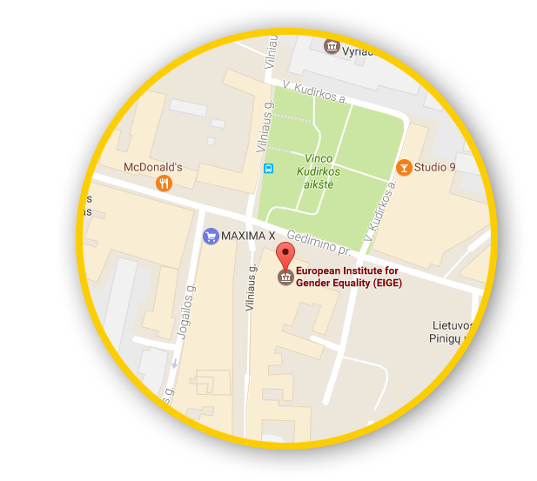





Let’s talk
Connect with us!
eige.europa.eu
facebook.com/
eige.europa.eu
twitter.com/
eurogender
come in for a chat!
eige.europa.eu/
newsletter
eurogender.eige.
europa.eu
youtube.com/
user/eurogender
Gedimino pr. 16,
LT-01103 Vilnius,
Lithuania

